Slide 1
PlanBuild Tasmania
Application Services End-user Training
- Getting Started -

Slide 2
Delete this page
Note for trainers:
This presentation is a template to assist trainers in preparing internal end-user training. Please feel free to tailor the content and details to suit your organisation or audience. E.g. you might want to create breaks or more Q&A sessions, or provide more details on a specific topic.
There are some grey text in the slides as prompts for you insert suitable content.
The illustrations are just placeholders, you might want to replace them to suit your presentation.

Slide 3
Welcome
Introductions
<Trainer Name>
Housekeeping
Fire exits and emergency assembly point
Bathrooms
Breaks
If you need to leave the session
Acknowledgement of Country ‘In recognition of the deep history and culture of this Island, we would like to acknowledge and pay our respects to all Tasmanian Aboriginal people; the traditional owners of the Land upon which we meet/gather.’

Slide 4
Agenda
1. | User registration
2. | Dashboard Navigation
3. | PlanBuild Hierarchy and Navigation
4. | Searching and References
5. | PlanBuild Statuses
6. | Managing Clocks
7. | Document Management
8. | Notes and Attachments
9. | Payments – Request to Pay & Upfront
10. | Allocating Tasks
11. | Understanding Enquiries

Slide 5
The Flow of This Training
The ‘Getting Started’ session will focus on general information about PlanBuild Application Services with the aim to understand:
The PlanBuild architecture, basic navigation & workflow
How to assign tasks, use the workflow & save records
The use of help & support functionality and tools
How to manage documents including revisions and document control
How to assign & manage task allocation (for specific roles only)
Future sessions will be more practical and will follow:
Demonstration of Day in the Life Scenario (DILO)
Participants to complete the DILO in PlanBuild Application Services
Each scenario should build on the steps from the previous scenario

Slide 6
Introduction of PlanBuild
PlanBuild Tasmania is a State Government initiative to provide more consistent, transparent and streamlined application processes to anyone who plans, builds, are carries out plumbing, environmental and public health projects.
Phase one of the PlanBuild Tasmania portal is to provide Enquiry Services and has been live for public use since February 2022.
Phase two is to deliver an Application Service Portal, which allows the users to apply, track and pay for their applications, respond to requests, purchase Land Title Certificates documents, and invite their suppliers or licenced parties to participate. On the other hand, TasWater will be able to receive, view and assess the applications electronically.
Provide brief information on your organisation’s adopting timeframe and why are you all here today.
Watch PlanBuild - Application Services Introduction Video to learn more.
Notes:
Video is optional if the learners have not had access to the demo environment / exposure to PlanBuild.

Slide 7
Let’s get started!

Slide 8
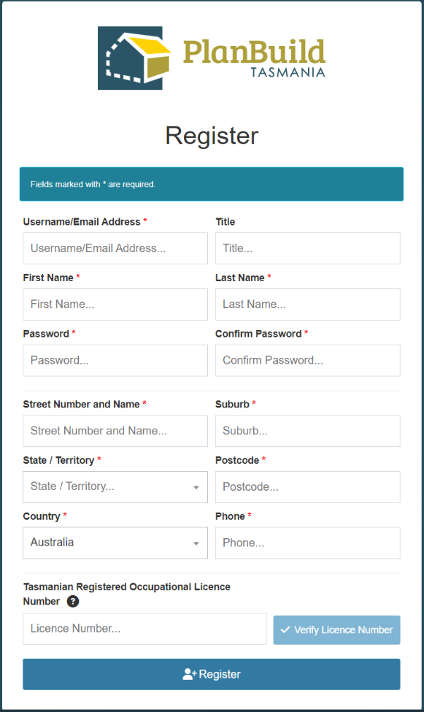
User Registration
In this section, we will go through the following:
Create a new user
Reset your password
View Organisation Details
Notes:
The user registration process is similar to registering for most websites.
The users will be sent an email to verify they have created their user profile.

Slide 9
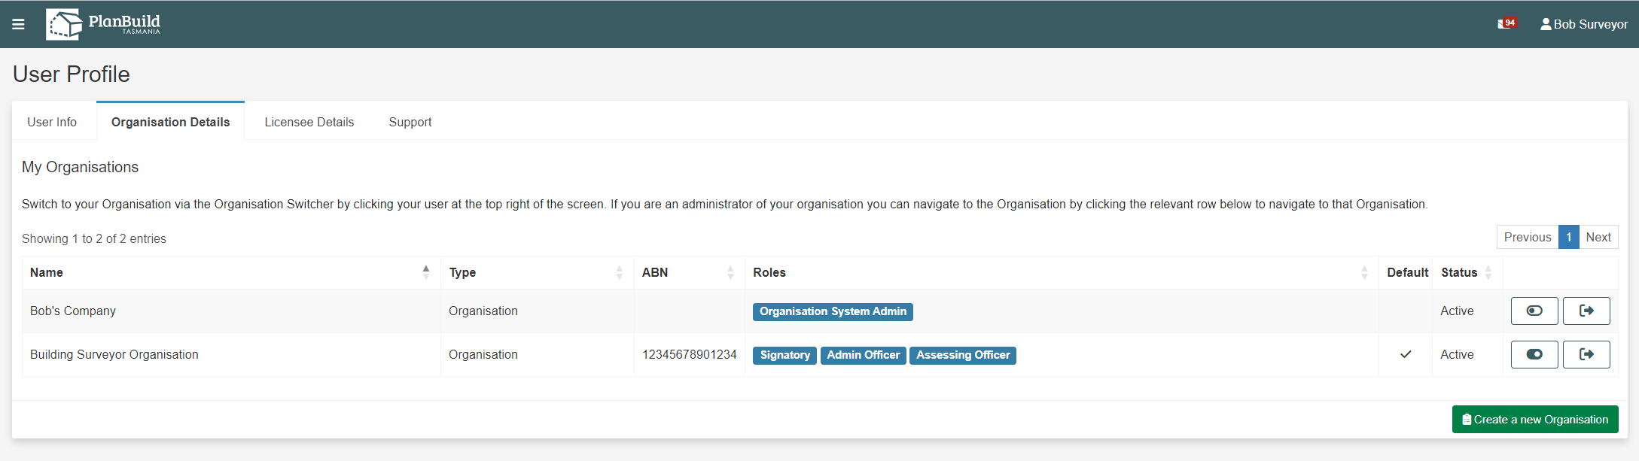
User Registration
User Profile
Notes:
TasWater will have control over creating users and will be able to set these up when new staff start.
TasWater will be able to assign the appropriate user role to these users (eg admin, assessor, etc)
Users will be able to add an electronic signature to their user profile.
Users can also delegate their signature to other parties in their organisation – this is however not utilised for TasWater.
Users can have an ‘individual’ profile and an ‘organisation’ profile.
User permissions determine what users can do to an application or project. If a user does not have the right permissions they may not be able to view tasks, access documents, view screens etc.

Slide 10
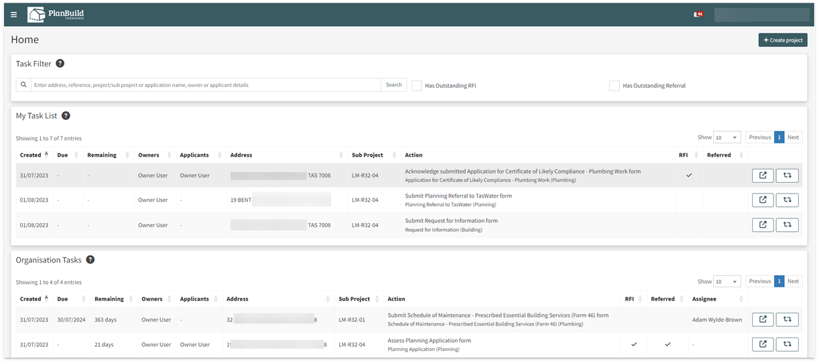
Dashboard Navigation
Notes:
PlanBuild Mailbox
Notifications will appear in your PlanBuild mailbox when certain actions are performed (such as a task being assigned to you).
The email address used when registering will also receive a copy of this notification via email.
Logged in user details
The top right hand of the ribbon menu shows the logged in user details.
This can be used to switch between organisation profiles (if user has multiple), or access profile setting.
This can also be used to ‘sign out’.
Create a Project
You can create a project by selecting ‘Create a Project’ and follow the prompts. This will be covered in detail in ‘Creating a Project’.
Side bar menu
Home – Used to return to the dashboard, you can also select the PlanBuild Tasmania logo in the banner menu to return to the dashboard.
Search – You can select the dropdown to search by different categories. This will be covered in detail in ‘Searching’.
Payments – You can see the details of any payments made as an individual or for your organisation.
Reporting – This will only appear if you are required to access the reporting functionality.
Help – This can be used to access additional help resources.
Task Filter
You can search for tasks using the search bar.
Has Outstanding RFI can be selected to filter out application tasks which have an RFI/Invoice that is yet to be completed by the applicant.
Has Outstanding Referral can be selected to filter out any active tasks which have been referred (internally or externally) and are outstanding.
My Task List
This section shows any tasks currently assigned to the logged in user.
Tasks are allocated to your My Task list when you select a task from the Organisation Tasks or if the task is assigned directly to you.
Organisation Tasks
This section shows all tasks in the user’s organisation, details of who the task is currently assigned to in the ‘Assignee’ column.
Tasks can be opened and claimed from this section (regardless if they already have an assignee or not).
Assigning of tasks by a manager will be covered later.

Slide 11
Dashboard Navigation
Notes:
Action buttons
Tasks can be opened in the same tab by clicking anywhere along the task row.
The action buttons for tasks are shown on the right-hand side of each task:
The ‘pop-out’ icon will open the task in a new tab.
The ‘Referrals’ icon will show a summary of any (internal/external) referrals associated with the task.
Recent Sub Projects
The four most recent Sub Projects the user has performed an action on will be displayed here. Select ‘See all’ to see a complete list.
Recently Completed
The four most recent forms the user has completed will be displayed here. Select ‘See all’ to see a complete list.
My Properties
The four most recent properties the user has performed an action on will be displayed here. Select ‘See all’ to see a complete list.
My Enquiry List
Any Enquiries completed by a user once registered (and whilst logged in) will appear at the bottom of their dashboard. Note: you do not need to be registered to use the Enquiry Service.

Slide 12
PlanBuild Hierarchy and Navigation
Notes:
PlanBuild has a hierarchy of:
Property
Project
Sub Project
Application
Tasks
All applications must be related to a property address.
Actions on a project/sub-project are driven by forms or tasks.
Users should be made aware of how to navigate from project, sub-project, to application by using the ‘Project Panels’.
The PlanBuild Tasmania icon in top banner will take the user back to their Dashboard.
The ‘Burger’ icon will hide the left hand side navigation bar.

Slide 13
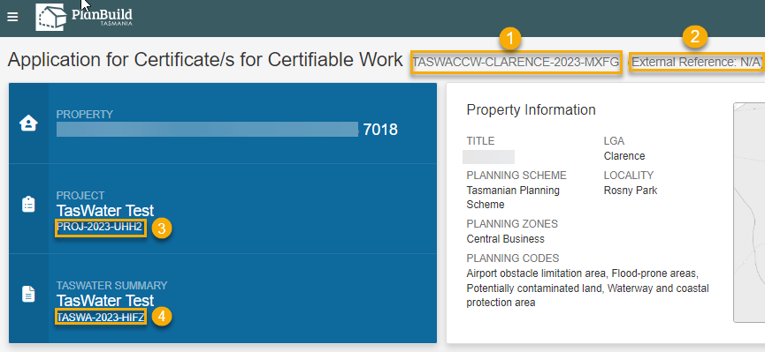
Searching & References
PlanBuild Reference
TasWater Reference (optional)
Project Reference
Sub Project Reference
Hint: You can use the panels above to navigate back to the Property, Project or Sub Project!
Notes:
PlanBuild References
PlanBuild creates a unique identifier for a project, sub-project and an application.
The prefix for the reference will be the year, however the latter parts of the reference will be randomly generated.
Users can enter their own ‘External Reference Number’ – this is already set for TasWater
The External Reference Number will be displayed in the top navigation bar and will be able to be searched using the ‘Search’ functionality.
Note that 1 and 2 (TasWater Reference (PlanBuild) and permit authority reference are more frequently used in an authority, 3 and 4 are just for the trainees’ references.

Slide 14
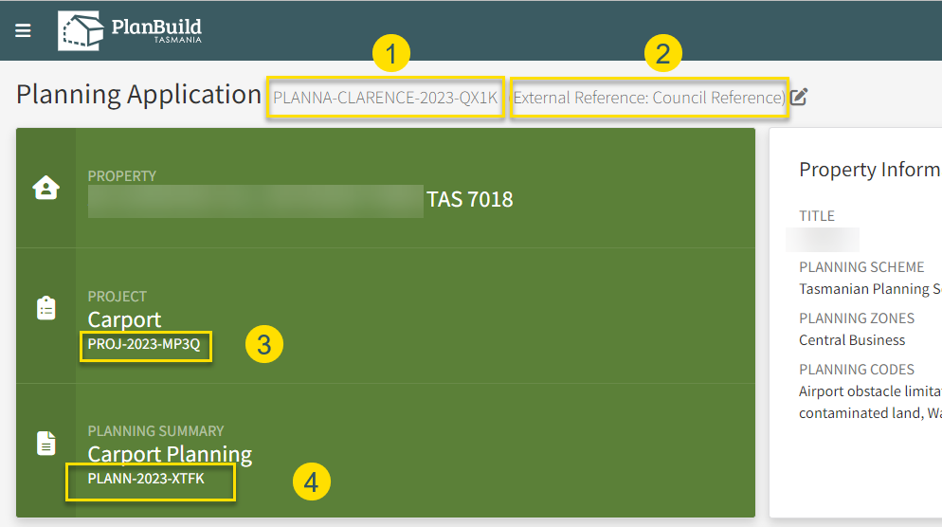
Searching & References
PlanBuild Reference
Council Reference (optional)
Project Reference
Sub Project Reference
Hint: You can use the panels above to navigate back to the Property, Project or Sub Project!
Notes:
PlanBuild References
PlanBuild creates a unique identifier for a project, sub-project and an application.
The prefix for the reference will be the year, however the latter parts of the reference will be randomly generated.
Users can enter their own ‘External Reference Number’ – this is already set for TasWater
The External Reference Number will be displayed in the top navigation bar and will be able to be searched using the ‘Search’ functionality.
Note that 1 and 2 (TasWater Reference (PlanBuild) and permit authority reference are more frequently used in an authority, 3 and 4 are just for the trainees’ references.

Slide 15
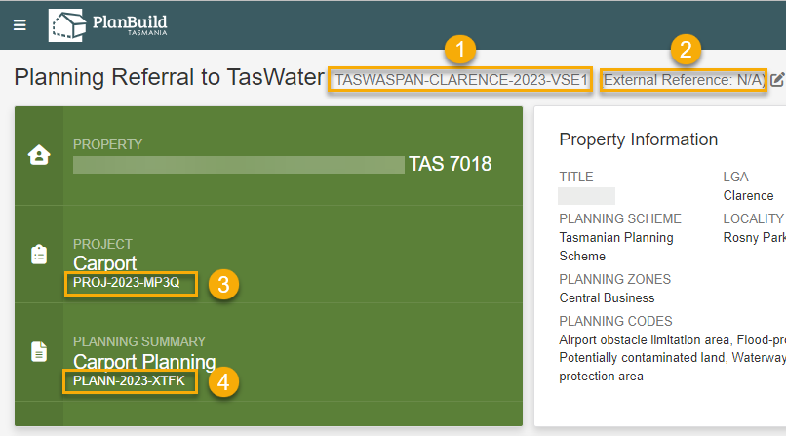
Searching & References
PlanBuild Reference
TasWater Reference (optional)
Project Reference
Sub Project Reference
Hint: You can use the panels above to navigate back to the Property, Project or Sub Project!
Notes:
PlanBuild References
PlanBuild creates a unique identifier for a project, sub-project and an application.
The prefix for the reference will be the year, however the latter parts of the reference will be randomly generated.
Users can enter their own ‘External Reference Number’ – this is already set for TasWater
The External Reference Number will be displayed in the top navigation bar and will be able to be searched using the ‘Search’ functionality.
Note that 1 and 2 (TasWater Reference (PlanBuild) and permit authority reference are more frequently used in an authority, 3 and 4 are just for the trainees’ references.

Slide 16
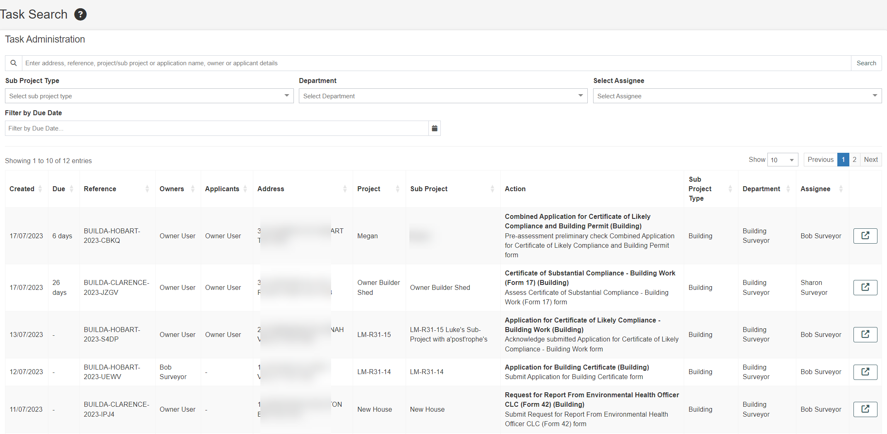
Searching & References
The search bar
Task Search
Notes:
Searching
Searching can occur from the left hand side navigation bar
Users can search by a property, project, sub-project or task
Users should be able to view items that their organisation has been involved in (e.g. if an application has been referred to TasWater, TasWater staff should be able to view specific parts of that project/sub-project or application).
Managers can track workload using the Task Search option, with the ability to view across their Department / Organisation.

Slide 17
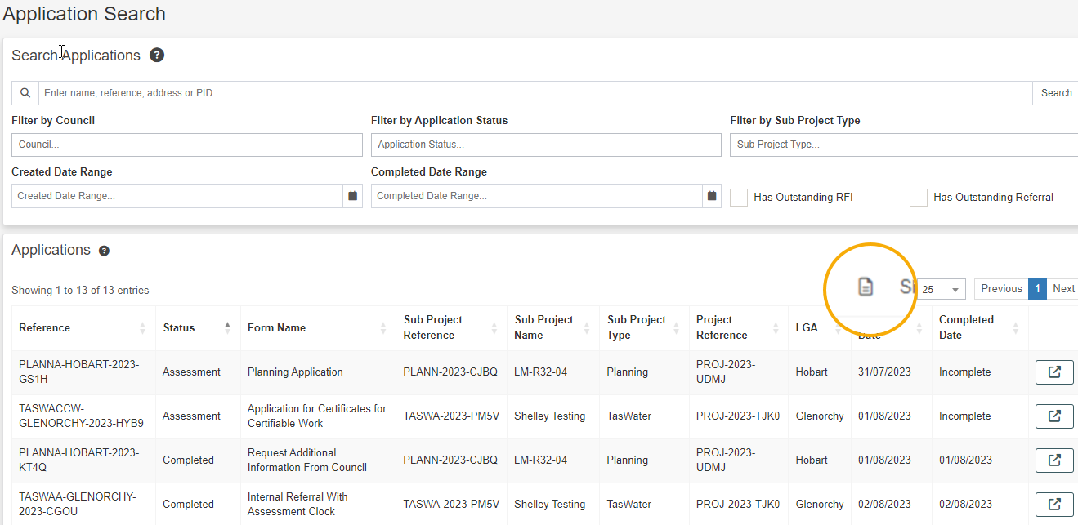
Searching & References
Application Search and report generating function
Notes:
Search results can be exported. Users should be advised that this may impact on performance so if exporting, endeavour to use specific criteria. If more extensive data is required this should be sought using the PlanBuild Reporting functionality.
When searching, applications that have been referred or where a request for information has been requested can be filtered (i.e. these will still be able to be accessed but will not display as ‘active’ tasks for users to do).

Slide 18
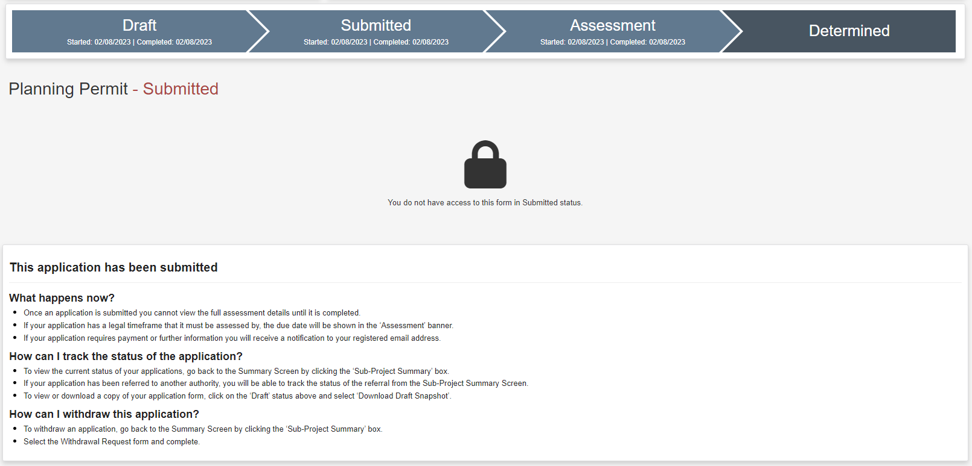
PlanBuild Statuses
Notes:
Statuses
PlanBuild applications are largely broken into 4 key statuses – Draft, Submitted, Assessment, Completed, however statuses may vary depending on the application type
Statuses can be viewed using the ‘Status Chevron’
Users related to a project will have different views of the application status based on the role they have e.g. an applicant will be able to see that an application has been referred to TasWater or Heritage Tasmania, however the applicant will not be able to view the content of the referral.
To move an application from one status to another relies on the completion of a task.
Some users will not be able to edit applications in particular statuses (e.g. assessment) if they do not have the assessor role.

Slide 19
Managing Clocks
Notes:
Overview of clocks
Now that users have viewed the statuses, trainers can provide an overview of how the clocks will work.
Clocks are set at the form level (e.g. a CCW application form will have its own clock)
Some forms will not have a clock set (as it does not apply). In these cases the due date will not be displayed.
Clocks can be managed by users with the user role to do so
Some forms (e.g. a permit authority referral ) will be determined by the permit authority before they start the assessment clock
Updating the clock
PlanBuild has included substantial functionality to manage clocks and to ensure that they were not able to be changed without appropriate process.
When an Assessment Officer has selected to start the assessment, the user will select the start date and select the period, If the assessment period needs to be changed after it has been initially set, there are 2 ways in which this can occur:
1. Using the Adjust Assessment Timeframe
Adjust Assessment Timeframe
Officers should use the Adjust Assessment Timeframe when there is an internal reason to change the clock. This allows a user to move the clock back or forward.
The officers can select themselves if they are authorised to adjust the clock, alternatively they can select to send this to another officer who to review and approve the change.

Slide 20
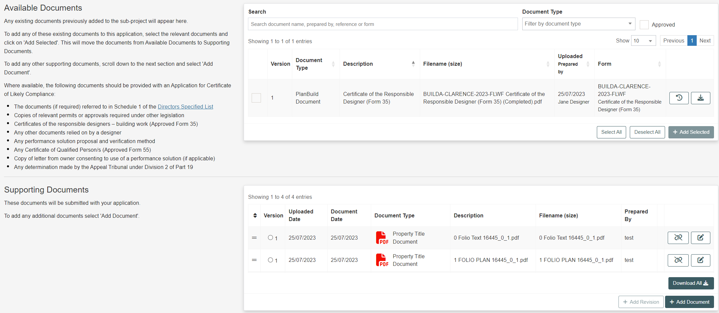
Document Management
From the Applicant’s view:
Notes:
Document overview
A key benefit of PlanBuild is to allow for the sharing of documents with parties involved in the project (e.g. the applicant, the Council, Referral Authorities, Building Surveyors etc).
When lodging applications, PlanBuild has been set up to allow a user to pick from documents that are available for the sub-project so that these can be passed through to other applications.
This functionality will be covered in detail in specific subject training courses.
For an applicant:
Most applications will include two sections – Available Documents and Supporting Documents.
The purpose of the Available Documents section is to display to an Applicant the documents that are available on the sub-project that they may want to re-use for the purpose of lodging a new application that requires a document that has been uploaded but for a different application, for example plans.
If there are no documents in the ‘Available Documents’ section it means that there are no previously uploaded documents for that sub-project.
Applicants have the option to move documents from Available Documents to Supporting Documents so that they are submitted to the approving body with that particular application.
The Supporting Documents section is displayed to the Applicant to show them any documents that they have selected from the Available Documents section and allowing them to add any New Documents to be submitted with their application.

Slide 21
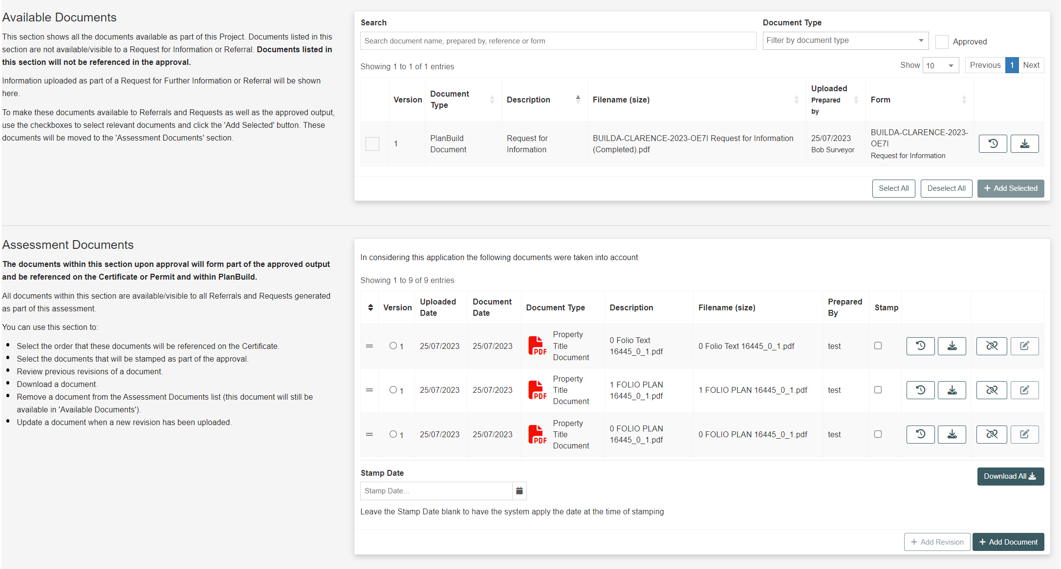
From the Assessment Officer’s view:
Notes:
For an approval body:
When an application is submitted, the documents that the applicant has selected as Supporting Documents as part of the application will be available for TasWater to view.
The officer can then select some or all of these documents to be included in the ‘Document Pack’. These are the documents that will be provided back to the applicant when the assessment is finalised.
Where the application is approved, documents that are in the Document Pack can be stamped to show they are approved documents.
This will be covered in more detail in specific subject training courses.

Slide 22
Document Management
Revisions
Notes:
Revisions
When uploading a document a user will be required to enter the document type, description, revision date, who the document was prepared and licence details of that person if required.
The Revision Date is the date on the document itself (e.g. the date on a plan)
Users can add one or many documents at once.
If the user selects to ‘Upload and Add Another’ as part of the same upload process the document type will be the same for both documents.
TasWater users may need to correct the document details when they are submitted (e.g. if the applicant uploads a single pdf including a suite of documents, TasWater may choose to separate these into their own unique documents.

Slide 23
Notes and Attachments
Within the applications:
At the bottom of the Sub Project page:
Notes:
Notes
The internal notes and attachments section can be used to capture internal notes, which will not be viewable by users outside your organisation (e.g. the applicant).
In some instances the notes section can be used if re-assigning a task to add details to another user for specific action required of them (your organisation will instruct you on your business process for the use of notes).
Notes will be automatically timestamped and details of the logged in user will be applied so there is no need to include this in your note.
Notes made on an assessment screen will also be shown on the Sub-Project Summary Screen. On this screen the particulars of the note as well as who made the note, on which form the note was made and the date of the note will be visible to all other users within the Organisation. Users not within the organisation will not have access to the note summary.
Attachments
To upload an attachment you can toggle to the ‘Attachment’ tab. Here you can store any correspondence with an applicant externally of PlanBuild (e.g. emails).

Slide 24
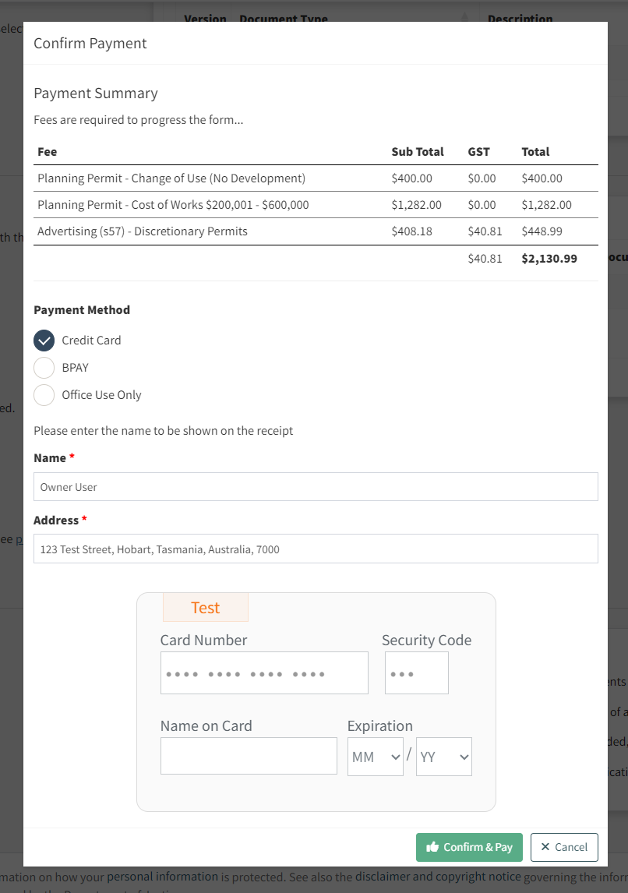
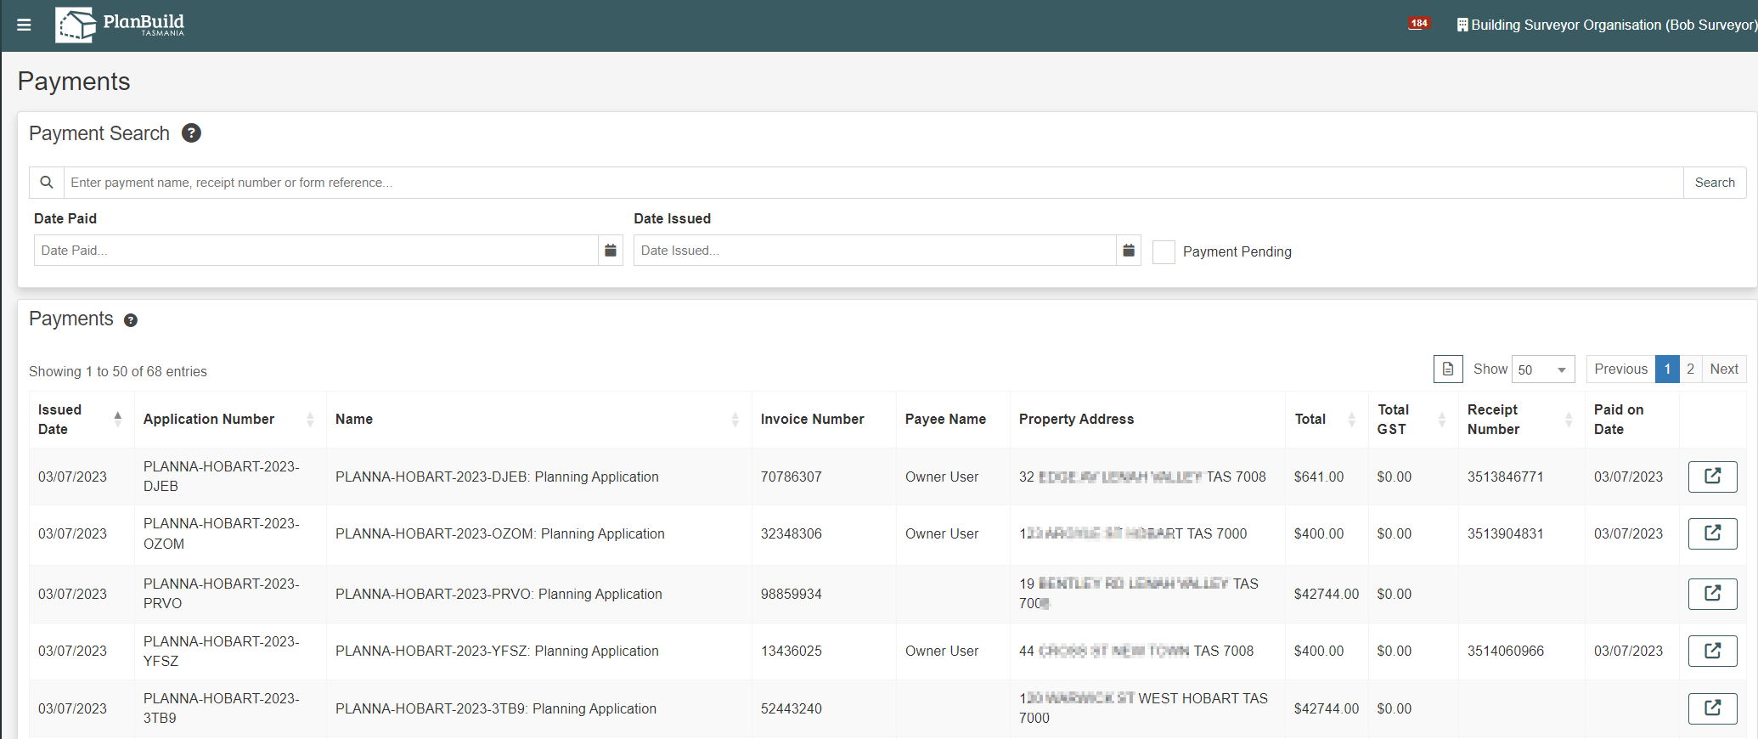
Upfront Payments
Upfront payment screen
Payments page
Notes:
Trainers to provide an overview of how payments will be received and viewed using PlanBuild.
PlanBuild will charge upfront once TasWater adopts upfront payments. TasWater fees and charges will be within PlanBuild.
Payments can be made using credit card or BPay.
Credit card payments over $10,000 is not permitted
Upfront payments only
Fees will be calculated based on the fee types configured against the forms and per the TasWater fee type structure.
When making a payment, the user can select the payment type from credit card or BPay.
There is a third option for ‘office use only’ this will allow the application to be submitted without making a payment. The user will need to provide a reference as to why they are eligible for a discount or waiver, and it will be clear to the TasWater that a payment has not been made.
If additional payments are required after submission, a user can raise a request for payment after the application has been submitted.
Requests for Payment
If TasWater are not adopting upfront payments, a user can raise a request for payment after the application has been submitted.
This will create a task for the applicant to log in and make a payment using credit card or BPay.
Payment Details
Any user within TasWater has the ability to search for payment details for applications.
There is a button on the submitted and assessment screens which will take the user to any payment details associated with the application.

Slide 25
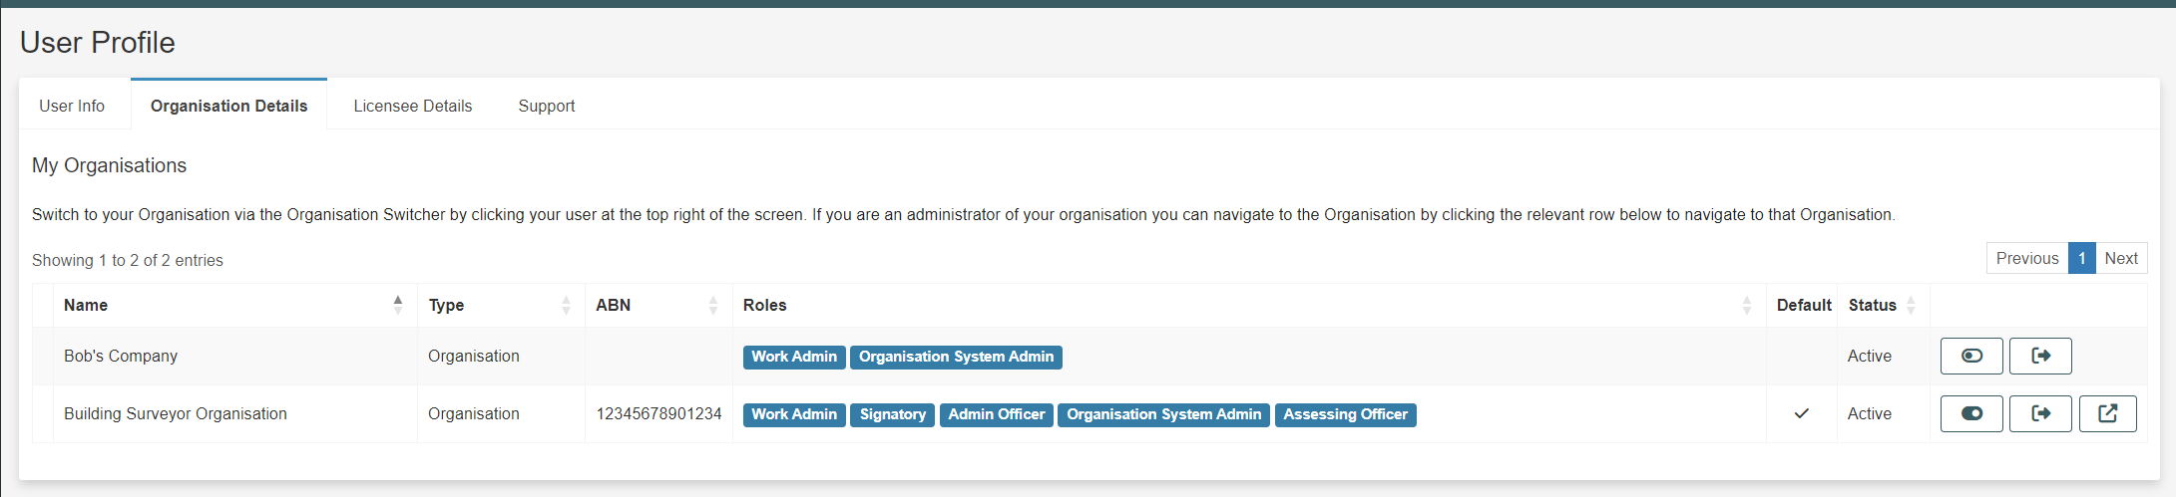
Allocating Tasks
Users with an 'Organisation System Admin' role can assign roles for other users under Organisation Profile.
Users with a ‘Work Admin' role can assign tasks for other in the Task Search page.
Notes:
Allocating Tasks
Tasks can be assigned to other users as required
Users who have the appropriate user role will be able to reassign tasks in bulk (e.g. where a party is unwell/on leave a manager will be able to select all of that user’s task and reassign to another party.

Slide 26
Understanding Enquiries
Visit the PlanBuild Tasmania Enquiry Page to know more.
Notes:
Enquiry Service
The Enquiry service allows anyone to enter an address in the portal to see what planning zones and codes apply to a property.
A Property Report can be generated which includes maps, details of the planning zone, codes and other information that affect the selected property.
For those properties that fall under the Tasmanian Planning Scheme, PlanBuild Tasmania provides a comprehensive Guided Enquiry service, including identifying planning, building and plumbing rules that may apply to a proposed project.
A proposed project could include changes to your residential property, such as building a deck, adding a deck or doing internal renovations.
PlanBuild Tasmania will also provide information on food businesses and operating a risk-based business, such as a tattoo parlour that requires specific licenses.
You will be able to work through a series of questions on your proposed project resulting in information on:
who to consult (e.g. local, council, TasWater, Heritage Tasmania)
who can do the work (e.g. a licensed builder)
what to apply for (e.g. a permit).
After completing an enquiry if you have additional questions or want to request advice from a council, this can be lodged online using PlanBuild Tasmania.
How does the Enquiry Service link to Application Services
Any enquiries undertaken, whilst registered and logged in will be saved at the bottom of the users PlanBuild Dashboard.
The user can refer back to previous saved enquires using the dashboard.
This functionality will be adopted and switched on a date to be confirmed for TasWater.

Slide 27
Any Questions?

Slide 28
What is next?
Feedback survey
Available resources: UAT / User Manual PlanBuild Tasmania Website
Further / In-depth trainings / practises?
Timeline about the adoption of PlanBuild Application Services – expectation on user’s knowledge and skill

Slide 29
Thank you.
If you have a question or need any further assistance, please contact: <Trainer’s contact>

