Slide 1
Train the Trainer
Course
Notes:
Notes for Trainers:
Welcome, introduce yourself and invite participants to introduce themselves and their role.

Slide 2
Background
PlanBuild Tasmania is a State Government initiative to provide more consistent, transparent and streamlined application processes for planning, building, plumbing and related environmental and public health applications.
Phase one of the PlanBuild Tasmania portal is to provide Enquiry Services and has been live for public use since February 2022. In this time, we have received over 57900* enquiries via the portal.
Phase two is to deliver an Application Service Portal, which allows people to apply, track and interact with the relevant parties for the life of a project. It has been developed in consultation with local government, industry, referral authorities, including TasWater, Heritage Tasmania and TasFire, to ensure it is fit-for-purpose for all who will use it.
* Figure as of 18 Sept 2023
Notes:
Address that while the new portal is providing huge convenience and efficiency for all parties, we understand this will also bring significant changes to Councils in terms of work flow, approval processes, staff induction and documentations etc.
Train the Trainer Course is designed to equip and empower internal trainers of the adopting organisation to confidently train other users within the origanisation about the PlanBuild.

Slide 3
We are here to help.
Training materials
Provide Trainers generic training materials
Familiarise Trainers with training materials
Support and quality review of your customised training materials - if required.
Training support
Support trainer readiness pre-training
Attend end-user training sessions (if required) to support trainers
Training preparation
Identify trainers in your organisation
Support trainers in conducting Training Needs Analysis
Support development of training delivery plan for your orgnaisation
Train-the-Trainer
PlanBuild ‘subject matter training’ with trainers
Conduct ‘Train the Trainer’ sessions with trainers
Support training ‘practice’ sessions with trainers - if required.
FAQs and training experiences sharing
Training follow up
Conduct ‘post-training’ learnings workshop with Trainers to share feedback
Refine training materials (if required)
Deliver follow up ‘trainer’ sessions (if required)
Support follow up and review feedback from ‘trainees’ post training
Notes:
Notes for Trainers:
Use this slide to provide an overview of the PlanBuild Tasmania training offering to set the scene as to why participants are here.
How did we get here:
Famil
Deep Dive
Training
you have had the opportunity to provide input so far, no this is training, not requirement gathering.
Outline the objective of train the trainer offering in terms of empowering user organisations to support their existing and new staff without a dependency on the PlanBuild project team
There are 5 phases as listed in the PowerPoint, but we can always come back to earlier phases if needed – e.g. we can discuss if the training materials need to be modified after an end-user training has been conducted, or, if the trainer feels like they need further training or practise on the subject matters.

Slide 4
Course Content
Course Title – Train the Trainer
Time | 1 Hour
Audience | Trainers
Pre-requisite courses | Business Education Program
Learning Activities | Training Curriculum Overview Introduction to Day-In-The-Life (DILO) Scenario based training Running the training sessions Where to find support & resources
Learning Outcomes | At the end of this session, participants will be familiar with the training approach including: How to deliver the required courses to end users within your organisation How to learn the necessary content and facilitation skills to confidently and accurately train others in the use of the PlanBuild Tasmania Application Services functionality How to use Day-In-The-Life Scenarios for training
Notes:
Notes for Trainers:
Use this slide to set the scene for the Course, how long people are expected to be here, what they can expect to know when they leave.

Slide 5
Course objectives
This course is the first in a series of training sessions to ensure you can train end users in their organisation confidently, and support the organisation’s external clients.
We will:
Outline the content and objectives of each course.
Review the materials needed to run each session with you.
Provide training materials that offers contextual information about the PlanBuild Tasmania solution, facilitation notes, background information and points for discussion.
We expect you to:
Familiar yourselves with all the training and end-user training materials before using them in the trainings.
Let us or your internal Change Lead know if you need any further assistance.
Provide guidance on how to use the training materials.
Be well-prepared and confident in yourselves as this will make your ‘students’ feel supported and understood and that Trainers can accurately answer if they have a question.
Become very familiar with the PlanBuild Tasmania solution and the benefits of it.
Notes:
Notes for Trainers:
Use this slide to reinforce to participants that they need to prepare for the training sessions in order to support their teams and their staff.
“We know the system, but you know your organisation better than we do” – so we are counting on you and empowering you tailor these generic courses to suit the needs of your users and organisation
Outline the expectation that trainers should review the training materials they will be provided and they must familiarise themselves with the way PlanBuild Tasmania works prior to running a training session.

Slide 6
Training Material: The Train-the-Trainer package
You will receive:
PlanBuild Tasmania Training Manual, which provides facilitation notes and highlights the points to cover for trainers
Training Curriculums
Training presentations with slide notes for each course (where applicable)
Training packages for printing and providing to end user participants
Pre training checklist
Post training survey (for end users)
Training videos and more
Notes:
Notes for Trainers:
Participants should be provided printed copies at the time of the training however they should also be made aware that this will be available online on the Council User Resources web page and therefore will be updated.
Advise participants that the document will include version control so that they can check if their printed version has been updated.

Slide 7
Before End User Training
Notes:
Notes for Trainers:

Slide 8
What End User Training Courses do we provide?
PlanBuild Tasmania End User Training Courses include:
Getting Started
Planning Application – Administration
Planning Application – Assessment
Building Application – Administration
Building Application – Assessment
Plumbing Application – Administration
Plumbing Application - Assessment
Environmental Health – Administration and Assessment
Public Health – Administration and Assessment
Organisation Administration
Notes:
Notes for Trainers:
Use this slide to outline all courses that are available.
Advise participants that they should be aware of which specific courses they are responsible for training. This should have been outlined to them when they were selected to deliver the training
Reinforce that all parties require ‘Getting Started’

Slide 9
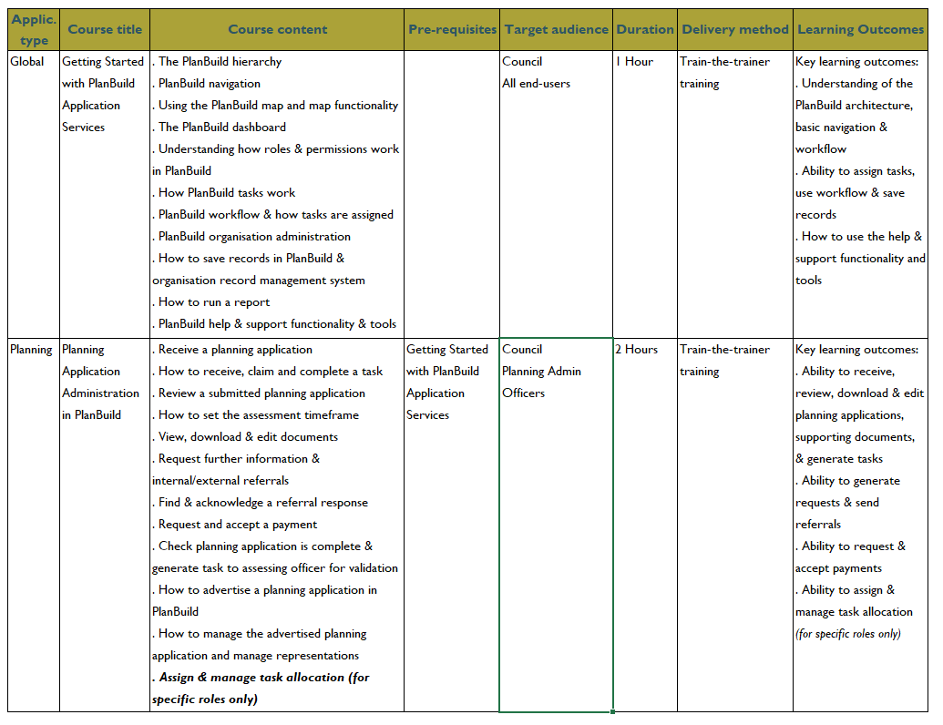
Training Curriculum
A sample of the Training Curriculum
Notes:
Notes to Trainers:
Advise participants that they will have a printed copy of the Training Curriculum
Advise that this slide shows only a sample of the training curriculum. They should review the training curriculum post session

Slide 10
Understanding the Curriculum - Day in the Life Scenarios
The PlanBuild Training Curriculum has been developed based on ‘Day in the Life’ scenarios of Council staff, which is to focuses the end user training on covering the key areas and functionality available in PlanBuild that should form the majority of the end user’s daily user experience.
It has been developed through consultation with Councils as to the main scenarios they encounter day to day in terms of planning, building, plumbing, environmental and public health
Notes:
Notes for Trainers:
Briefly explain what is DILO
Participants should have printed versions of the DILO scenario workbook for them to review.
In this section we will explain the purpose of the DILO’s and how they have been used to inform the training curriculum.
The next 2 slides will outline two example DILO’s for the participants

Slide 11
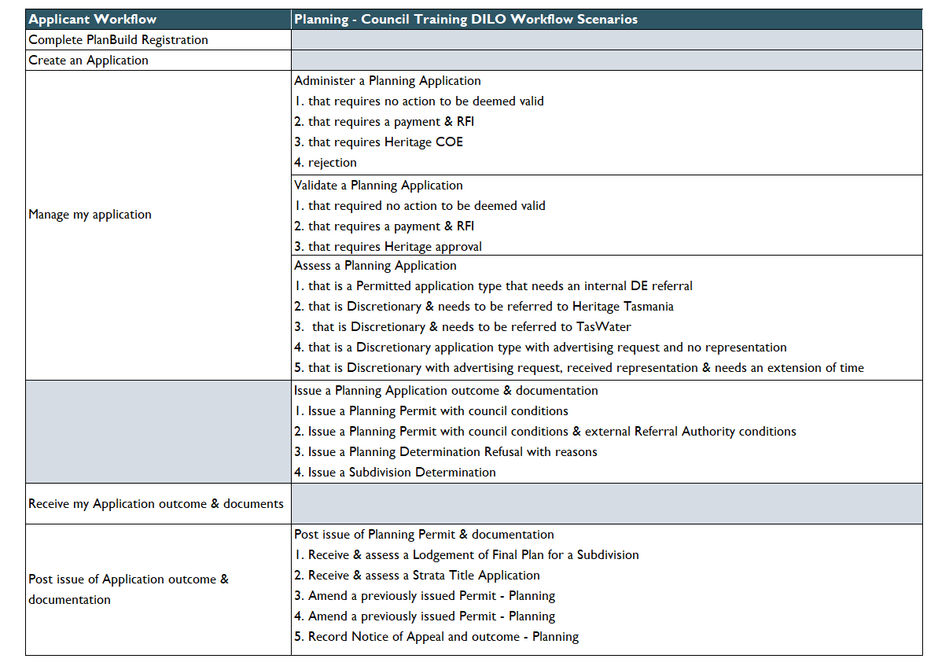
Example of Day in the Life Scenario – Planning
Notes:
Notes for Trainers:
Describe the DILO outlining that column 1 shows the Applicant Workflow and Column 2 outlines the steps undertaken by the Council in the life of a planning application
Outline that the scenarios endeavour to work through the ‘day in the life’ of a Councils Officers involved in Planning in that it goes through a number of primary and alternative scenarios
The purpose of this approach is to reinforce learnings as part of the end user training and to ensure that there is sufficient coverage of Planbuild functions to allow the participant to understand how other application types will work (as the end-user training will not cover all scenarios).

Slide 12
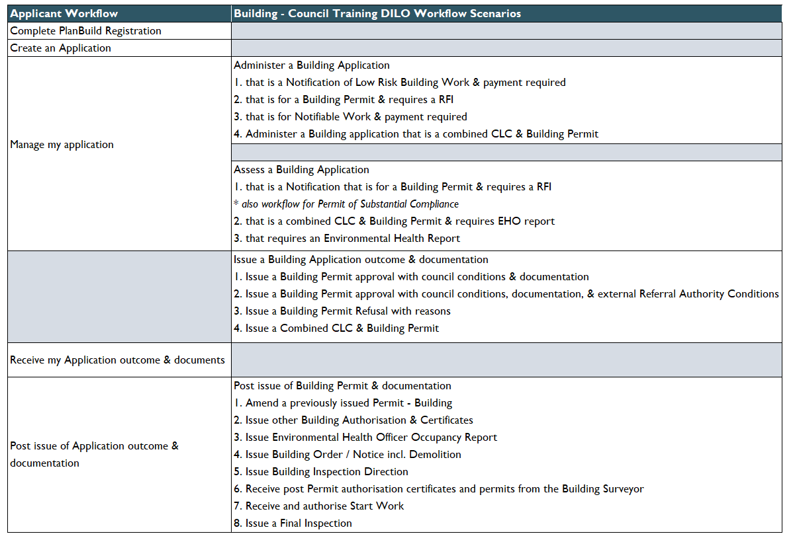
Example of Day in the Life Scenario – Building
Notes:
Notes for Trainers:
Go over this slide in the same detail as the planning slide i.e
Describe the DILO outlining that column 1 shows the Applicant Workflow and Column 2 outlines the steps undertaken by the Council in the life of a Building application
Outline that the scenarios endeavour to work through the ‘day in the life’ of a Councils Officers involved in Building in that it goes through a number of primary and alternative scenarios
The purpose of this approach is to reinforce learnings as part of the end user training and to ensure that there is sufficient coverage of Planbuild functions to allow the participant to understand how other application types will work (as the end-user training will not cover all scenarios).

Slide 13
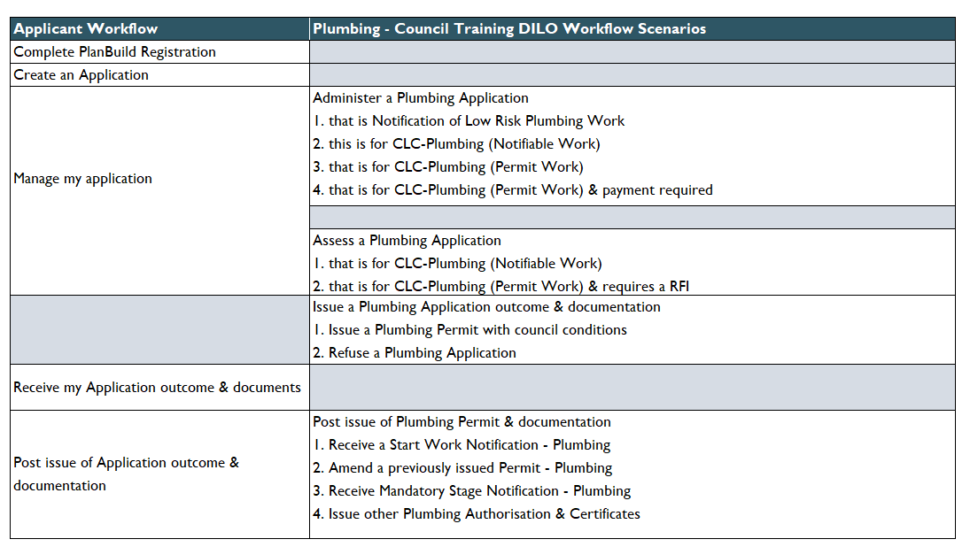
Example of Day in the Life Scenario – Plumbing
Notes:
Notes for Trainers:
Go over this slide in the same detail as the planning slide i.e
Describe the DILO outlining that column 1 shows the Applicant Workflow and Column 2 outlines the steps undertaken by the Council in the life of a plumbing application
Outline that the scenarios endeavour to work through the ‘day in the life’ of a Councils Officers involved in Plumbing in that it goes through a number of primary and alternative scenarios
The purpose of this approach is to reinforce learnings as part of the end user training and to ensure that there is sufficient coverage of Planbuild functions to allow the participant to understand how other application types will work (as the end-user training will not cover all scenarios).

Slide 14
Training Needs Analysis tool
First thing first, we need to know:
who needs to be trained?
what they need to be trained to do?
how do we do that? (availability of users, locations, etc)
Notes:
Notes for Trainers:
Use this slide to describe the Training Needs Analysis tool.
The purpose of this tool is to identify all users within your organisation who will require training AND what training they will require
This will need to be completed before the training sessions can be organised as it will determine not only the requirements of those you are going to train but the requirements in terms of rooms and locations.
Depending on your organisation and those involved in the PlanBuild project, this task may already have been completed and you will use it to inform the training.

Slide 15
Training Delivery Plan
Next, we can plan the training sessions:
Who will attend training
How the training will be delivered
The time of the training
Notes:
Notes for Trainers:
Use this slide to outline that once the TNA is completed the Training Delivery Plan can be finalised.
Note to the participants that depending on their organisation and those involved in the PlanBuild project, this task may already have been completed and they will use it to inform the training – they may have a Change Lead who has undertaken and / or will support them to do this task
Explain each column so that participants are aware of how to use the tool

Slide 16
Delivering
End User Training

Slide 17
Be prepared
Training course content reviewed?
Scenarios set up?
PlanBuild logons set up?
Users have right permissions?
Applications and projects created?
Condition and RFI libraries configured?
Fee rates configured?
Templates ready with logos?
Training Course package printed?
Feedback Survey printed?
Room booked?
Test documents saved to laptops?
Laptops set up?
PlanBuild accessible in training room?
Notes:
Notes for Trainers:
Notes to trainer – Use unique names for projects/use the correct LGA. Give troubleshooting tips.
Advise participants to refer to the ‘Pre-training course checklist’ which we recommend you complete prior to running the session.
Outline that the checklist will include the following points for you (or others assisting you) in setting up the PlanBuild Tasmania system, the room, the training materials, readying you for a successful session.

Slide 18
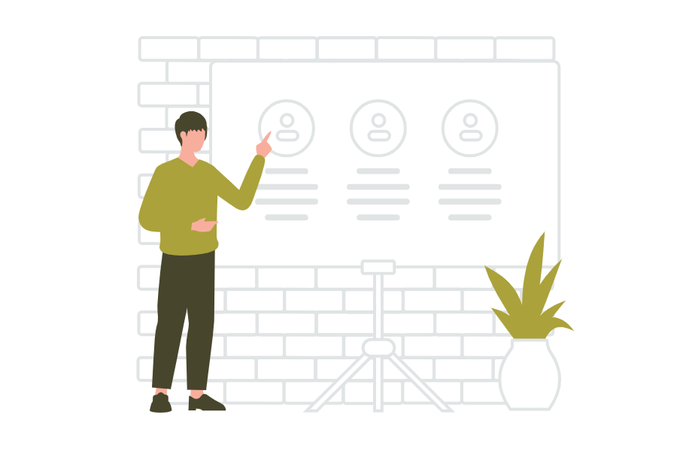
Opening the session
Introduce yourself to participants (if necessary)
Housekeeping – toilets, coffee/tea making facilities
Emergency exits/assembly points, etc.
WHS issues e.g. power cords
Mobile phones off/silent
Outline agenda for the day, including breaks
Set up a ‘Parking Lot’ to capture questions / issues that may arise
Notes:
Notes to Trainers:
Highlight that some of these items will not be relevant if the training is occurring in the participants work location.

Slide 19
Managing the session
Familiarise yourself with participants and identify if a (strategical) seating plan is required
Ensure participants have undertaken the necessary pre-requisite training
Seek internal support to manage challenging participants / change resistance should it arise in the session
Follow the speaking notes in the Training Materials
Monitor participants, are they keeping up, is additional reinforcement required
At the end of each learning activity, summarise learnings before moving to the next activity
Keep track of time
Notes:
Notes to Trainers:
Highlight that we recognise that some participants may not have delivered training previously. The next slides will go over some general principles and processes for training.
To manage the session, use the following strategies:
Familiarise yourself with participants
Some of the people you train may be your peers or even managers.
If you are aware that may be some participants who may pick up on concepts easier than others, set up a seating plan where these people can sit provide each other and provide support
Ensure participants have undertaken pre-requisite training
including the business education program. The purpose of that training is to ensure that business process/transition management questions are addressed PRIOR to the training. This allows the focus of the training to be on the PlanBuild tool itself.
Seek internal support
Identify any problematic/resistant participants. This may be done through the training needs analysis
Discuss with managers about support required to manage any resistance to the change so that the focus is on the training

Slide 20
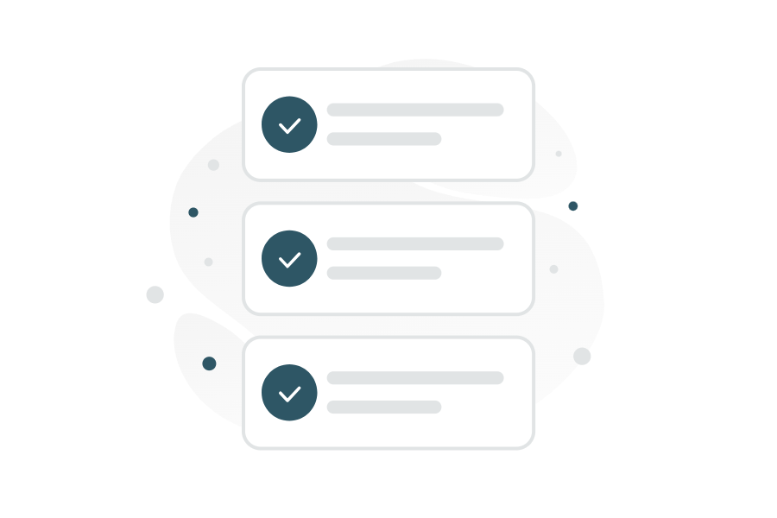
Closing the session
What are available for the users?
Post training learning resources
Access to the PlanBuild demo environment
Trainer’s contact for inquiries
What is next?
Training feedback survey
Need of practising! Reinforce the go-live date for your organisation
Notes:
Notes to Trainers:
Talk about the timing of survey to be sent, so that allows users to think about and practise the content, but not too late.
If there are unresolved questions from the training, trainer should mention about follow ups and when they will get back to the user.

Slide 21
Post
End User Training

Slide 22
After the First Training Session
Send the post training survey 2 days after the training session. Allow participants 5 days to complete the survey.
If as part of the survey response the participant identifies the need for further training, book a further session and offer to others.
And don’t hesitate to let us know if you need our help to:
Review / refine customised training materials
Review and discuss feedback from the users

Slide 23
Before the next training session
Familiarise yourself with the Train The Trainer materials
Review the training curriculum
Familiarise yourself with the training needs analysis and training delivery plan
Run through applications in PlanBuild demo environment to familiarise yourself with the navigation
Notes:
Note to Trainers:
Ensure all participants can access the Council User Resources
Let participants know that electronic versions of the printouts they have been provided will be available online – insert link
Videos

Slide 24
Questions?

